Slide 1

Discrete spatial choice in R
NSC-R Workshop April 14, 2022
Wim Bernasco

Slide 2
Choice
It is our choices, Harry, that show what we truly are, far more than our abilities.
Albus Dumbledore
Harry Potter and the Chamber of Secrets

Slide 3
Discrete choice examples
Consumer product – which coat to buy?
Leisure activity – go swim, play tennis, or Netflix?
Transport mode – take bus, train, bike or walk?
Restaurant – eat pizza, haute cuisine, or McDonalds?
Partnership – Jerry, Mike, Mike + Jerry, or stay single?
Holiday – Himalaya, Kruger Park, Veluwe, or stay home?
Notes:
Discrete choice is when someone makes a choice from a finite set of exhaustive and mutually exclusive alternatives. Exhaustive means that every possible course of action is included. For example, in the holiday destination choice, one altenative is to stay home. Mutually exclusive means that you can ony choose one course of action. This means that if, in the partnership example, if you decide to date both Mike and Jerry, this is a single alternative that is different form dating either make or Jerry.

Slide 4
Four elements of choice
Actors — who makes the decision?
Alternatives — what can they choose?
Attributes — how do alternatives differ?
Axioms — how do actors chose?

Slide 5
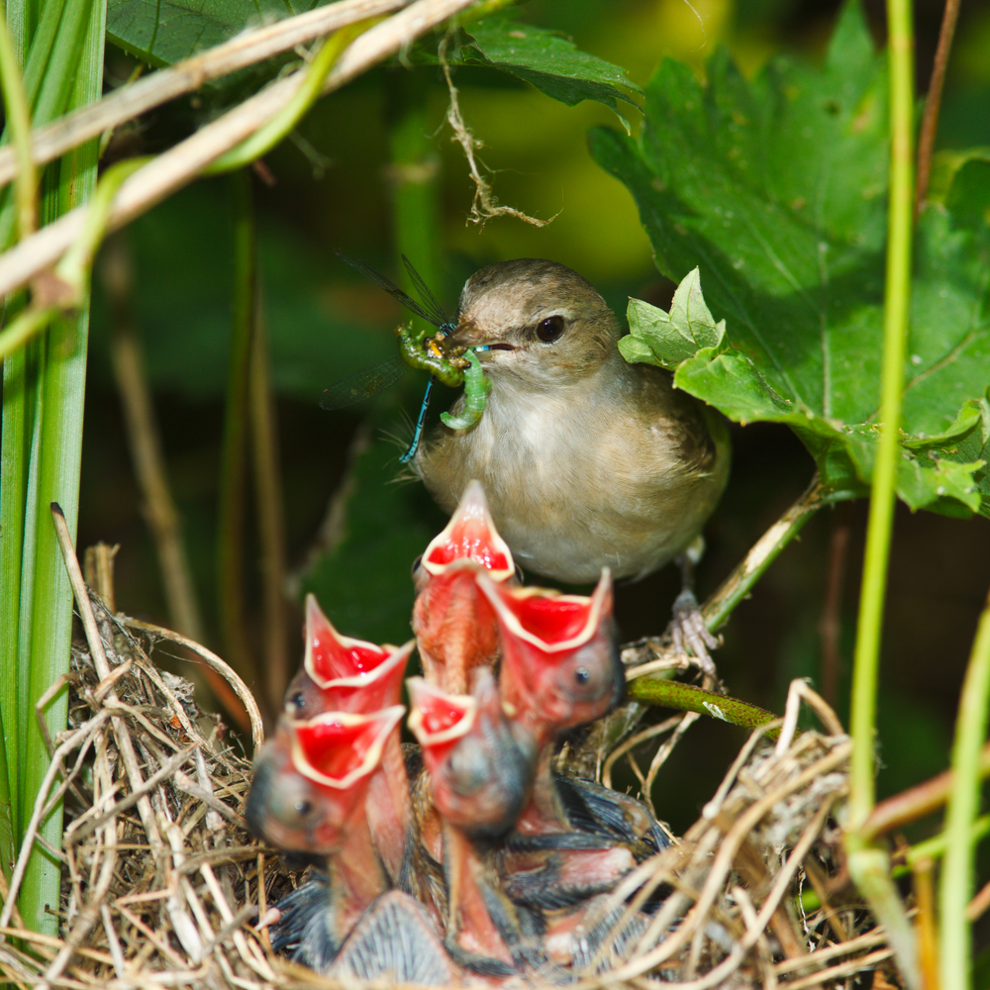
Foraging
Notes:
To put some flesh and bones to how we model discrete choice, I illustrate the key ideas with a foraging example. Image a parent bird with a nest full of hungry baby birds

Slide 6
Foraging
Notes:
The parent bird has to feed their young, and must forage for food in the environment. Let us assume that there are three different patches of land that offer food. Call them triange, square and circle. And let’s assume these are the only three patches available. Where should the parent go to get food for their nestlings?

Slide 7
Where to go? Distance
3
1
2
max (food – distance)
food

Slide 8
Where to go? Add food
3
1
2
max (food – distance)
food

Slide 9
Where to go? Add predators
3
1
2
max (food – distance – predators)
predator
food

Slide 10
Four elements of choice
Actors — the parent bird
Alternatives — triangle, square and circle
Attributes — distance, worms, cats
Axioms —

Slide 11
Four elements of choice
Actors — the parent bird
Alternatives — triangle, square and circle
Attributes — distance, worms, cats
Axioms — chose what maximizes utility (value)

Slide 12
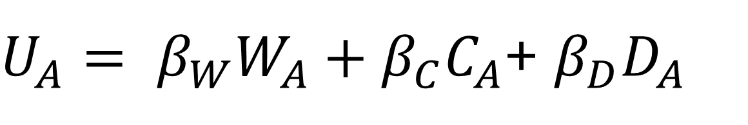
Where to go? Add math
3
$U_{A}= β_{W}W_{A}+β_{C}C_{A}$+ $β_{D}D_{A}$
2
predator
food

Slide 13
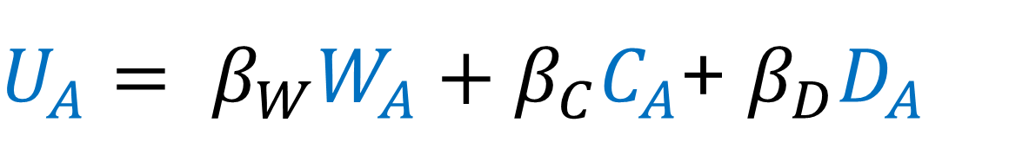
Where to go? Add math
3
$U_{A}= β_{W}W_{A}+β_{C}C_{A}$+ $β_{D}D_{A}$
value of A
cats in A
distance to A
worms in A
2
predator
food

Slide 14
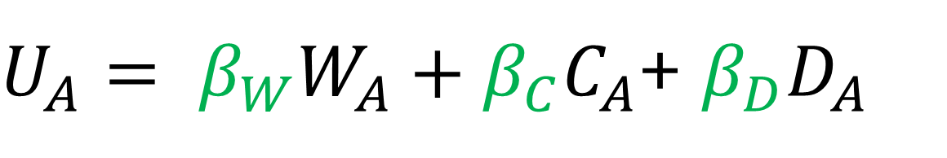
Where to go? Add math
3
$U_{A}= β_{W}W_{A}+β_{C}C_{A}$+ $β_{D}D_{A}$
weight for cats
weight for worms
2
weight for distance
predator
food

Slide 15
Where to go? Add math
3
$U_{A}= β_{W}W_{A}+β_{C}C_{A}$+ $β_{D}D_{A}$
Value of alternative A is weighted sum of its attributes W, C and D
2
predator
food

Slide 16
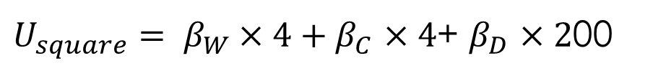
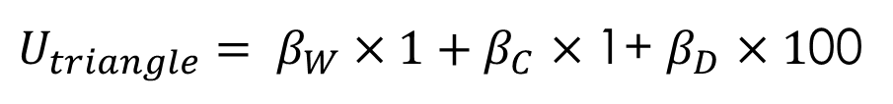
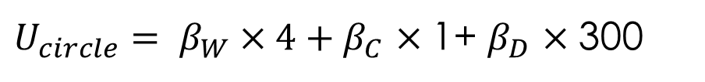
Where to go? Add math
3
1
2
$U_{triangle}= β_{W}×1+β_{C}$ $×$1+ $β_{D}$ $×1$00
$U_{circle}= β_{W}×4+β_{C}$ $×$1+ $β_{D}$ $×$300
predator
food
$U_{square}= β_{W}×4+β_{C}$ $×4$+ $β_{D}$ $×2$00

Slide 17
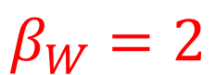

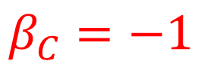
Where to go? Add math
3
1
2
$U_{triangle}= β_{W}×1+β_{C}$ $×$1+ $β_{D}$ $×1$00
$U_{circle}= β_{W}×4+β_{C}$ $×$1+ $β_{D}$ $×$300
Assume:
$$β_{W}=2$$
$$β_{C}=−1$$
predator
$$β_{D}=−.01$$
$U_{square}= β_{W}×4+β_{C}$ $×4$+ $β_{D}$ $×2$00
food

Slide 18
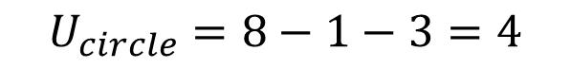
Where to go? Add math
3
1
2
$U_{triangle}=$ $2−1−1=0$
$$U_{circle}=8−1−3=4$$
Assume:
$$β_{W}=2$$
$$β_{C}=−1$$
predator
$$β_{D}=−.01$$
$U_{square}=$ $8−3−2=3$
food

Slide 19
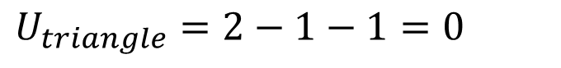
Where to go? Add math
3
1
2
$$U_{circle}=8−1−3=4$$
$U_{triangle}=$ $2−1−1=0$
Assume:
$$β_{W}=2$$
$$β_{C}=−1$$
predator
$$β_{D}=−.01$$
$U_{square}=$ $8−3−2=3$
food

Slide 20
Aim of discrete choice analysis
3
$U_{A}= β_{W}W_{A}+β_{C}C_{A}$+ $β_{D}D_{A}$
To estimate weight parameters
If weight = 0 : the attribute has no relation to the choice outcome
If weight > 0 : the attribute makes the alternative more attractive
If weight < 0 : the attribute makes the alternative less attractive
2
predator
food

Slide 21
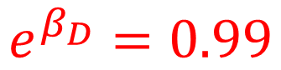
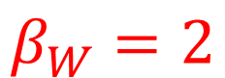

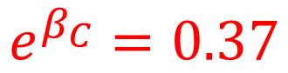

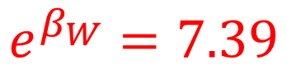
Interpretation
3
$U_{A}= β_{W}W_{A}+β_{C}C_{A}$+ $β_{D}D_{A}$
$$β_{W}=2$$
$$e^{β_{W}}=7.39$$
Odds of patch to be chosen increase by factor 7.39 for every additional worm
2
$$β_{C}=−1$$
$$e^{β_{C}}=0.37$$
Odds of patch to be chosen decrease by factor 0.37 for every additional cat
$$β_{D}=−.01$$
$$e^{β_{D}}=0.99$$
Odds of patch to be chosen decrease by factor 0.99 for every additional meter distance
predator
food

Slide 22
Data structure
Bird no | Alternative | Worms | Cats | Distance
101 | triangle | 1 | 1 | 100
101 | square | 4 | 3 | 200
101 | circle | 4 | 1 | 300

Slide 23
Data structure (add one bird)
Bird no | Alternative | Worms | Cats | Distance
101 | triangle | 1 | 1 | 100
101 | square | 4 | 3 | 200
101 | circle | 4 | 1 | 300
102 | triangle | 1 | 1 | 400
102 | square | 4 | 3 | 350
102 | circle | 4 | 1 | 150
Distances differ between birds because they have their nests in different places

Slide 24

Data organization
Bird no | Bird nest Coordinates | Choice
101 | 100, 200 | triangle
102 | 200, 150, | square
103 | 050, 250 | square
Alternative | Worms | Cats | Food Patch Coordinates
triangle | 1 | 1 | 150, 110
square | 4 | 3 | 220, 190,
circle | 4 | 1 | 200, 230
$$×$$
Choices
Alternatives

Slide 25
Data organization
Bird no | Nest Coordinates | Choice | Alternative | Worms | Cats | Alternative Coordinates | Distance | Chosen
101 | 100, 200 | triangle | triangle | 1 | 1 | 150, 110
101 | 100, 200 | triangle | square | 4 | 3 | 220, 190,
101 | 100, 200 | triangle | circle | 4 | 1 | 200, 230
102 | 200, 150, | square | triangle | 1 | 1 | 150, 110
102 | 200, 150, | square | square | 4 | 3 | 220, 190,
102 | 200, 150, | square | circle | 4 | 1 | 200, 230
103 | 050, 250 | square | triangle | 1 | 1 | 150, 110
103 | 050, 250 | square | square | 4 | 3 | 220, 190,
103 | 050, 250 | square | circle | 4 | 1 | 200, 230

Slide 26
Data organization
Bird no | Nest Coordinates | Choice | Alternative | Worms | Cats | Alternative Coordinates | Distance | Chosen
101 | 100, 200 | triangle | triangle | 1 | 1 | 150, 110 | 121 | 1
101 | 100, 200 | triangle | square | 4 | 3 | 220, 190, | 120 | 0
101 | 100, 200 | triangle | circle | 4 | 1 | 200, 230 | 164 | 0
102 | 200, 150, | square | triangle | 1 | 1 | 150, 110 | 64 | 0
102 | 200, 150, | square | square | 4 | 3 | 220, 190, | 45 | 1
102 | 200, 150, | square | circle | 4 | 1 | 200, 230 | 80 | 0
103 | 050, 250 | square | triangle | 1 | 1 | 150, 110 | 172 | 0
103 | 050, 250 | square | square | 4 | 3 | 220, 190, | 180 | 1
103 | 050, 250 | square | circle | 4 | 1 | 200, 230 | 151 | 0

Slide 27
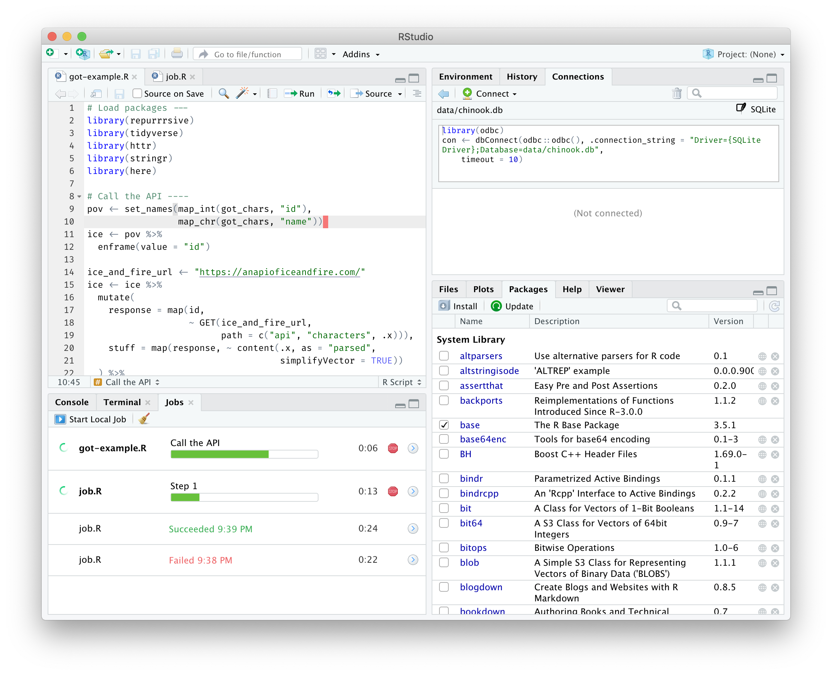
Next: discrete spatial choice in R

